Slide 1
Griffin Lim Algorithm
Dept. of Astronomy, Space Science
Chungnam National University
Yeji Jo

Slide 2
Process
Signal STFT
ISTFT
Compare with original signal
Masks
MSTFT = Mask * STFT
Griffin – Lim Algorithm
Compare with original signal

Slide 3
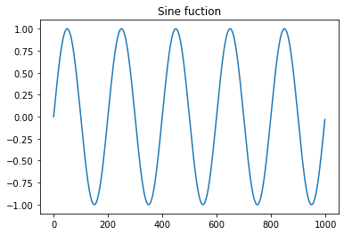
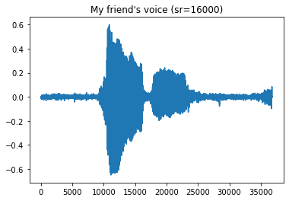
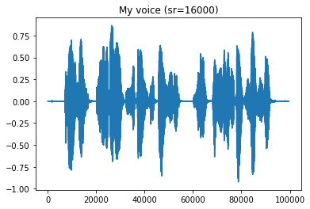
Signal
Sine Function
2. My friend’s voice
3. My voice

Slide 4
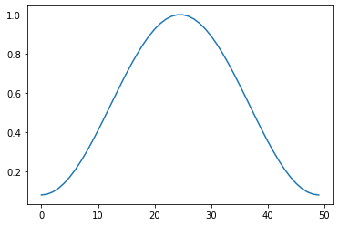
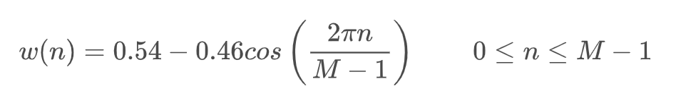
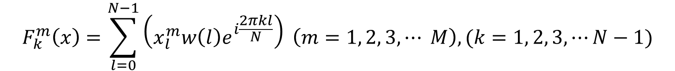

STFT
$$F_{k}^{m}\left(x\right)=\sum_{l=0}^{N−1}{\left(x_{l}^{m}w\left(l\right)e^{i\frac{2πkl}{N}}\right)} \left(m=1, 2, 3, ⋯ M\right), (k=1, 2, 3,⋯N−1)$$
Hamming Function

Slide 5
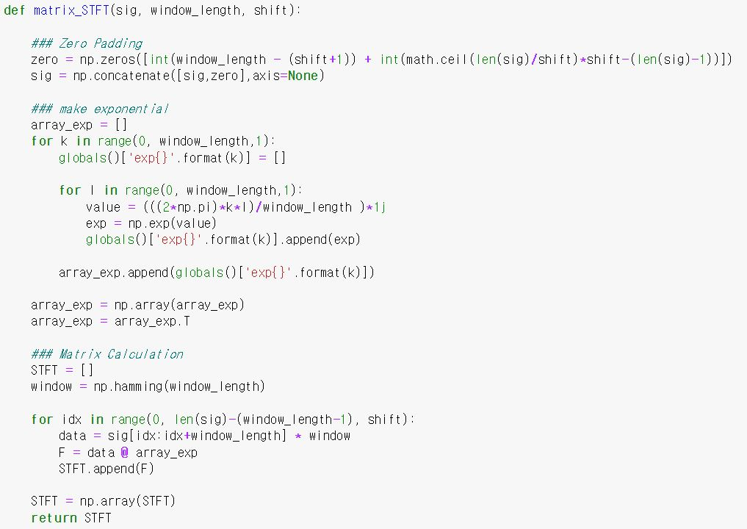
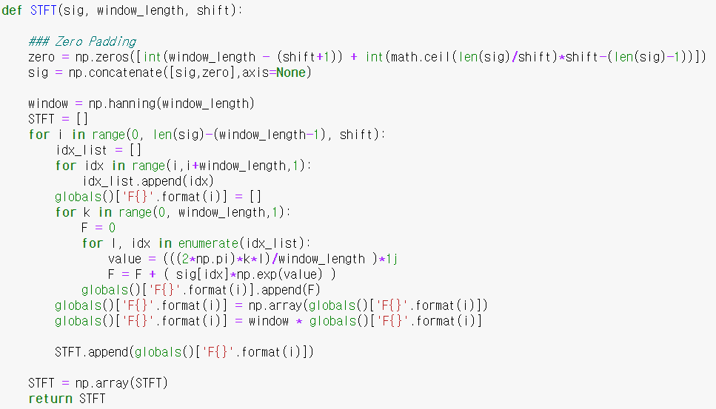
STFT

Slide 6
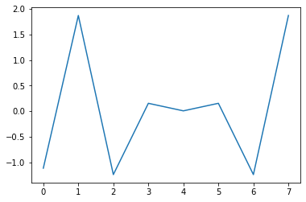
STFT
Calculate each element
Using matrix calculation

Slide 7
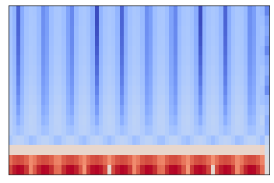
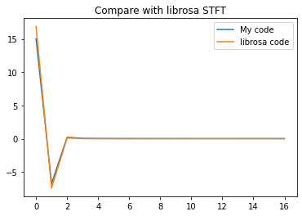
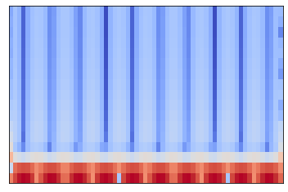
STFT – 1. sine function
My code
About one window
librosa code

Slide 8
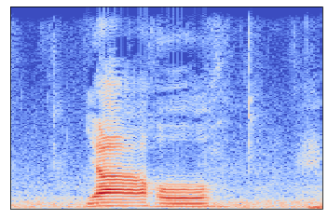
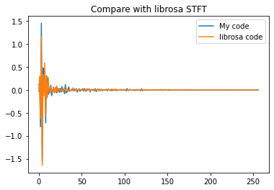
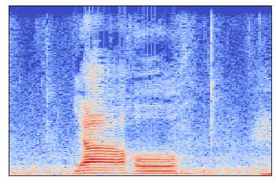
STFT – 2. My friend’s voice
My code
About one window
librosa code

Slide 9
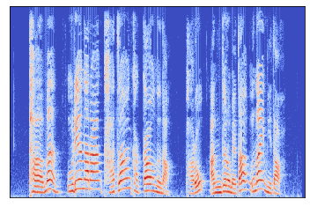
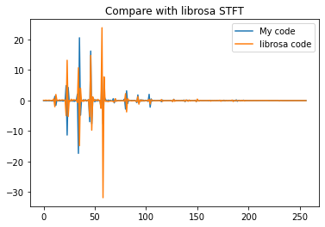

STFT – 3. My voice
My code
About one window
librosa code

Slide 10
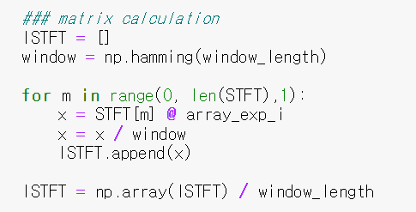

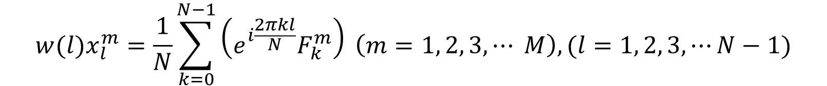

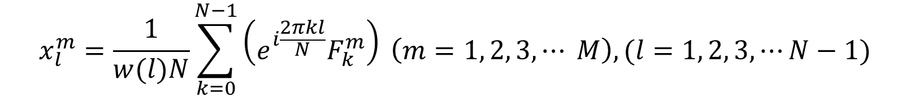
ISTFT
$$w(l)x_{l}^{m}=\frac{1}{N}\sum_{k=0}^{N−1}{\left(e^{i\frac{2πkl}{N}}F_{k}^{m}\right)} \left(m=1, 2, 3, ⋯ M\right), (l=1, 2, 3,⋯N−1)$$
$$x_{l}^{m}=\frac{1}{w(l)N}\sum_{k=0}^{N−1}{\left(e^{i\frac{2πkl}{N}}F_{k}^{m}\right)} \left(m=1, 2, 3, ⋯ M\right), (l=1, 2, 3,⋯N−1)$$

Slide 11
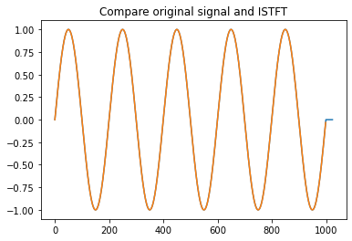
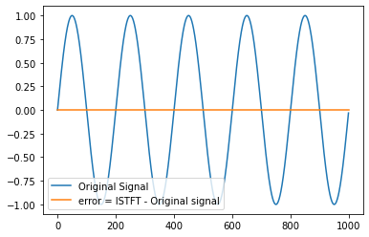
ISTFT - 1. sine function

Slide 12
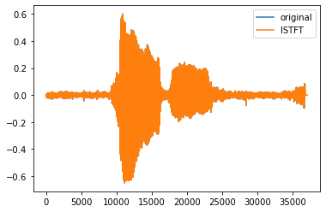
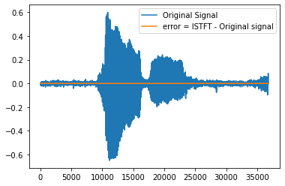
ISTFT - 2. My friend’s voice

Slide 13
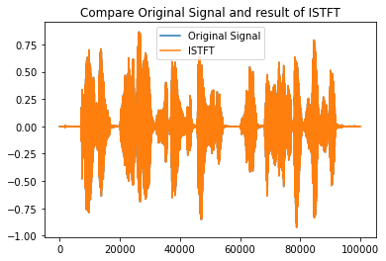
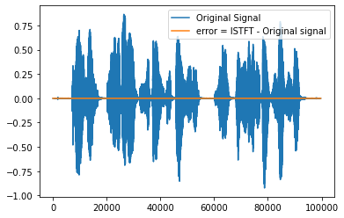
ISTFT - 3. My voice

Slide 14


Griffin-Lim Algorithm
$$F_{k}^{m}\left(x\right)=\sum_{l=0}^{N−1}{\left(x_{l}^{m}w\left(l\right)e^{i\frac{2πkl}{N}}\right)} ×Mask=MSTFT$$
$$\left(m=1, 2, 3, ⋯ M\right) (k=1, 2, 3,⋯N−1)$$

Slide 15
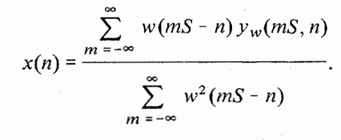




Griffin-Lim Algorithm
IMSTFT
$$y_{w}=w(l)y_{l}^{m}=\frac{1}{N}\sum_{k=0}^{N−1}{\left(e^{i\frac{2πkl}{N}}Y_{k}^{m}\right)}$$
$$\left(m=1, 2, 3, ⋯ M\right), (l=1, 2, 3,⋯N−1)$$

Slide 16
Griffin-Lim Algorithm
N
N
2
IMSTFT 1
000000000000000000
000000000000000000
+
+
2
000
IMSTFT 2
000000000000000
000
000000000000000
+
+
2
000000
IMSTFT 3
00000000000
000000
00000000000
+
+
…
…
up_sum
down_sum

Slide 17
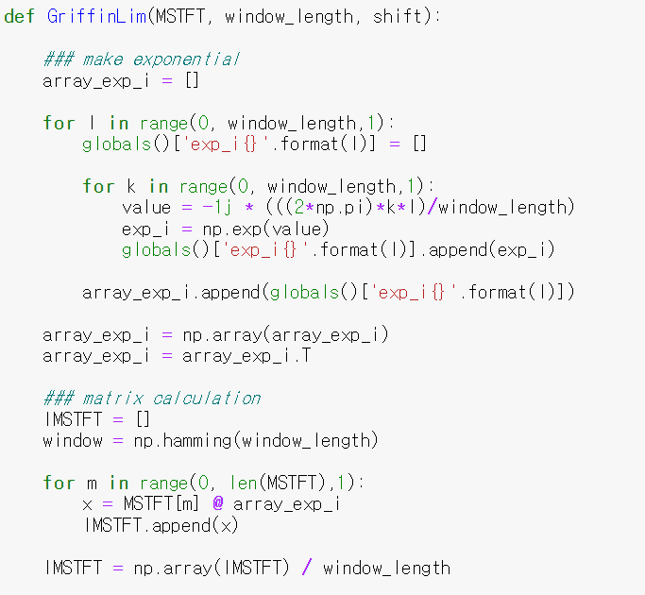
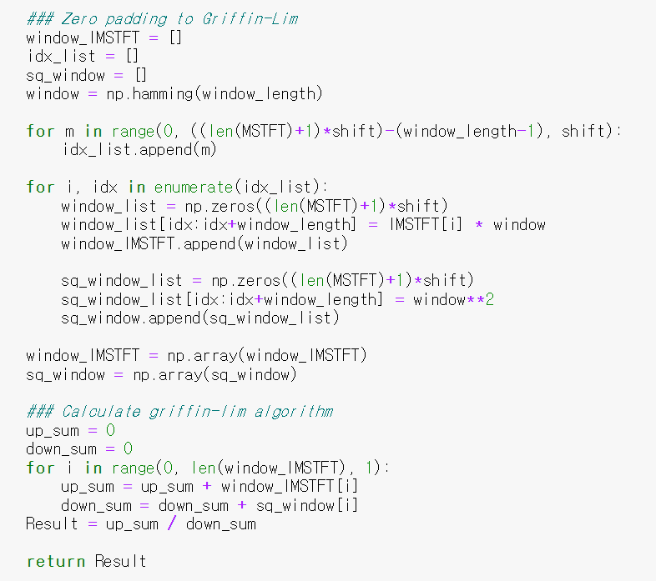
Griffin-Lim Algorithm

Slide 18
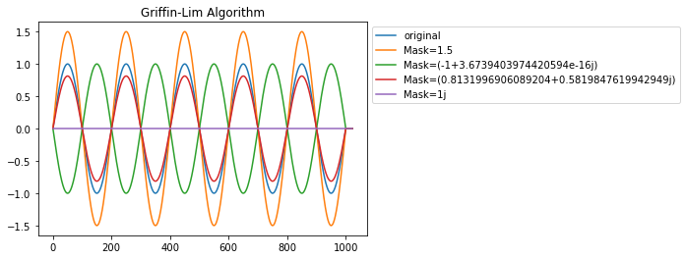


Griffin-Lim Algorithm - 1
Mask1 = 1.5
Mask2 = $e^{3πi}$ = -1
Mask 3 = $e^{20000i}$
Mask 4 = $e^{\frac{π}{2}i}$ = i

Slide 19
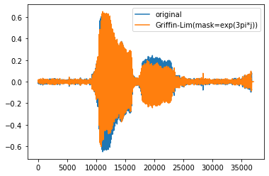
Griffin-Lim Algorithm - 2
Original Sound
G-L Sound

Slide 20
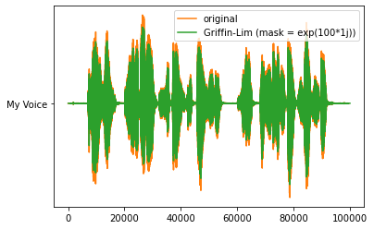
Griffin-Lim Algorithm - 3
Original Sound
G-L Sound

